Slide 1

Autogluon Library
an open source AutoML framework.
Open Siurced by Amazon web services

Slide 2

Are you working in Data science?
Do You also face the same issues?
When will all this be over?
Is the approach that I have used correct?
Isn’t there a simple library available that can do everything for me?

Slide 3

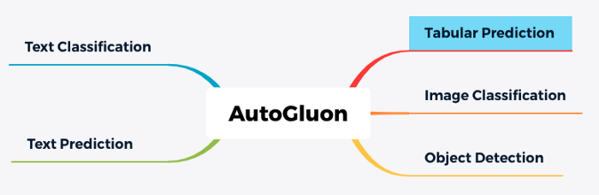
Introducing the Autogluon Library…
It is an open source framework that can train all state-of-art machine learning model using a single line of code.
It can train the models for various goals shown below:
While image and videos applications take all the attention, Let us first dive into Autogluon’s tabular approach.

Slide 4
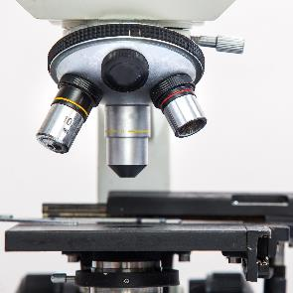

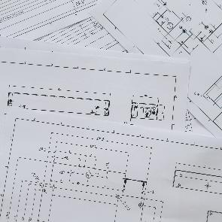



AutoGluon-Tabular’s approach to AutoML
It mainly works on unprocessed tabular CSV files.
Key Principles kept in mind while designing the Autogluon Tabular library:
Simplicity: No preprocessing required
Robustness: Can handle many variety of datasets and trains even when one of the model fails
Fault Tolerance: Training can be stopped and started at any time
Predictable Timing: Users can specify the time in which you want the results to be returned
1
2
3
4
5
6

Slide 5
AutoGluon API
Predict()
Fit()
Dataset()
AutoGluon-Tabular users only need to know how to use three Python functions:

Slide 6
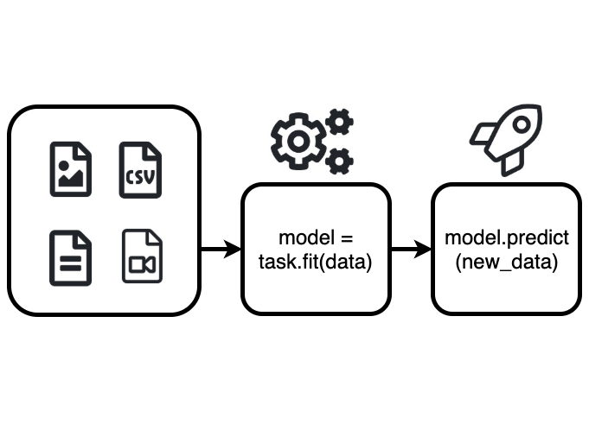
Steps to run code in Autogluon
Step 1: Load dataset.
Step 2: Fit models.
You can load the dataset using the Dataset() function.
data = task.Dataset(DATASET_PATH) .
It will return your csv file as a Dataframe.
This function shows all the magic of autogluon library.
It studies the dataset and prepares it for training.
predictor = task.fit(data_train, label=LABEL_COLUMN_NAME)
Step 3: Make prediction
The predict function generates
It studies the dataset and prepares it for training.
predictor = task.fit(data_train, label=LABEL_COLUMN_NAME)

Slide 7

The magic of the fit() function
The fit function majorly does two things:
1. Data Pre Processing and
2. Model Fitting

Slide 8
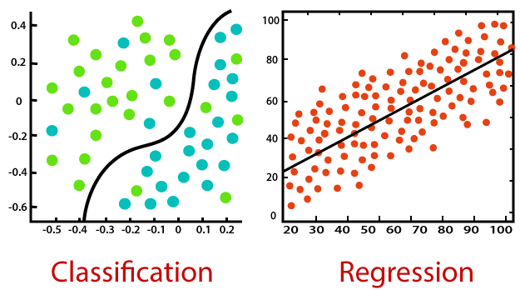



Data Preprocessing
Below are the steps that performed in Data Preprocessing:
Decides whether it is a classification problem or a regression problem looking at the target column
Removes columns with unique values and separates features into categorical, numerical, text or date/time
Missing values are replaced with ‘Unknown’
Other preprocessing work is done according to the model that will be trained.

Slide 9

Model Fitting
After Data preprocessing this library train a series of ML models on the data in the below sequence:
First
Reliably performant models like Random Forest
Second
Less reliable models like KNN
The idea behind the above approach is that there is a parameter that allows user to put a time constraint on the training time of the model. Therefore even under such constraints the model will perform well.
AutoGluon-Tabular currently supports the following algorithms and trains all of them if no time limit is imposed:
1. Random Forests
4. LightGBM boosted trees
2. Extremely Randomized trees
5. CatBoost boosted trees
3. K-nearest neighbors
6. AutoGluon-Tabular deep neural networks

Slide 10
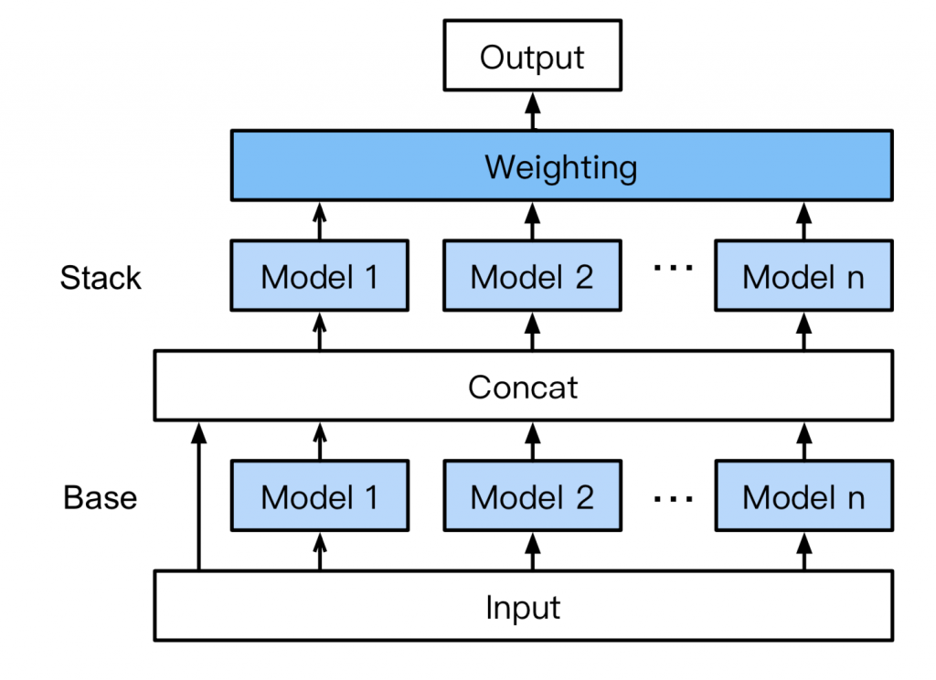
Ensembles and multi-layer stacking
Autogluon, introduces a novel form of multi layer stack ensemble. Here is how it works:
Base layer: Multiple base models are trained as mentioned before.
Concat layer: The data is then concatenated with the output of the base layer.
Stacker layer: Multiple stacker models are trained on the concat layer output. The Stacker layer re-uses the exact same models in the base layer, including their hyper-parameters as stacker models. It also gets an opportunity to look at the input dataset.
Weighting layer: The stacker models are introduced into a new ensemble such that the validation accuracy is maximized.
Image src: Erickson, Nick, et al. "AutoGluon-Tabular: Robust and Accurate AutoML for Structured Data." arXiv preprint arXiv:2003.06505 (2020).
Data A
Data B
Data C

Slide 11
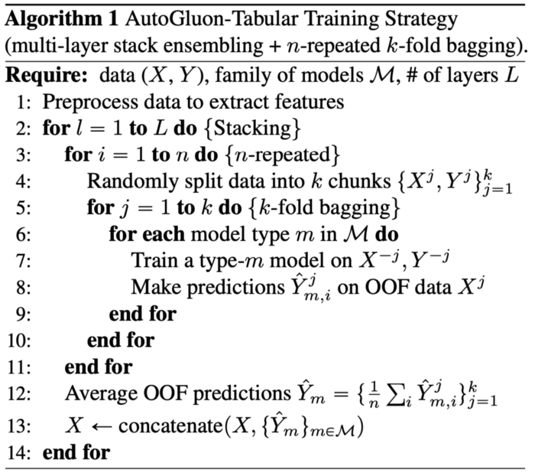
Below you can find the proper algorithm followed by the fit() function
Fit() function algorithm

Slide 12


Large Image slide
Fault tolerance:
AutoGluon-Tabular has some built-in protections for unplanned accidents:
Skips a layer if the training time exceeds the estimated training time
After completion of training of every model, it is saved in the disk
Can also anticipate when models may fail during training and skip to the next one.

Slide 13


Thank You
Akshita Sawhney
akshita@greatlearning.in

